Slide 1
Introduction to R, RStudio, and R Markdown/Quarto
Stephan Kadauke
R/Medicine 2025
Notes:
Greetings everyone.
In this session we are going to cover an introduction to R, Rstudio, and R Markdown / Quarto.

Slide 2




R
Programming language for
data analysis
RStudio
Interactive development environment (IDE)
R Markdown
Computational document format
Quarto
Computational document format
(R Markdown successor)
Notes:
I’m sure you all are excited to get started programming and we will do that in just a few minutes.
Before we do that I want to introduce you to 3 items.
The first is R. R is a programming language for data analysis. There are lots of great things about R: it is freely available, great for wrangling data, and very capable for producing impressive visualizations. There is also a great community of folks using it for data science, and we are excited to welcome you all to the R community via this course.
(**) Then, there’s RStudio. RStudio is the name of a free piece of software made by the company Posit (formerly known as RStudio). You can think of RStudio as a sophisticated text editor for writing R code. The technical term for this kind of software is IDE – integrated development environment. You can run RStudio on Mac or Windows, or on a server. For today’s workshop we’ll log you into a version of Rstudio that’s on a server called Posit Cloud. But after today you will want to download the Rstudio IDE for your computer.
You may have heard to Positron, which is an alternative for the RStudio IDE. At this time, Positron is in public beta so you can try it out if you like. For the time being, we recommend using Rstudio if you’re a beginner.
(**) Finally there’s Quarto. Quarto is a computational document format that has executable code. Quarto also includes capabilities for annotating your work which is incredibly handy and supports multiple programming languages for mixing and matching code. You might have heard of R Markdown. Quarto is the official successor to R Markdown and is very similar.
R, RStudio, and Quarto synergize for a robust ecosystem for performing data analysis.

Slide 3
Logging into RStudio on Posit Cloud
Notes:
Without further ado, let’s dive in!!
Getting Started with RStudio.

Slide 4
https://posit.cloud/content/10474813

Slide 5
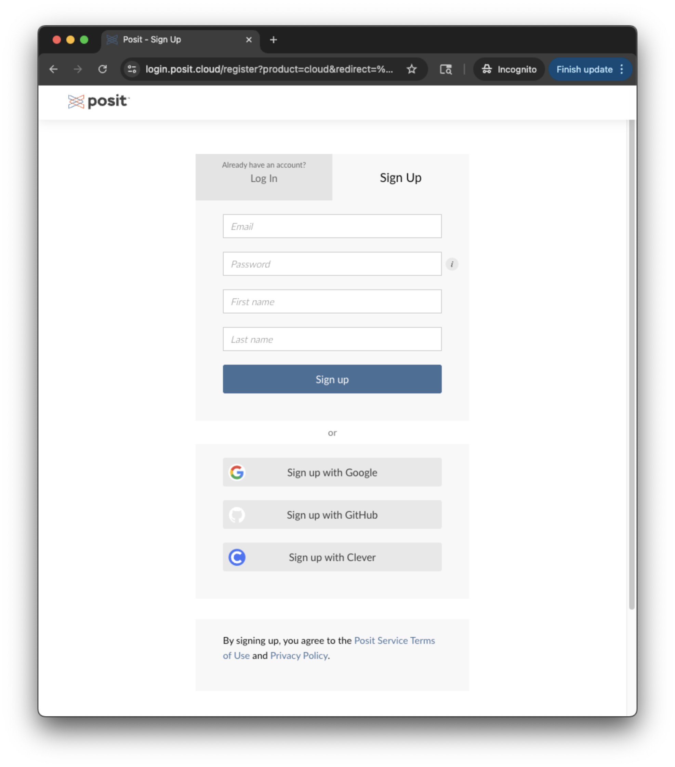
Notes:
If you don’t have a Posit Cloud account yet, click on the Sign Up tab and enter your email, password, first and last name. Alternatively, you go sign up with Google.

Slide 6
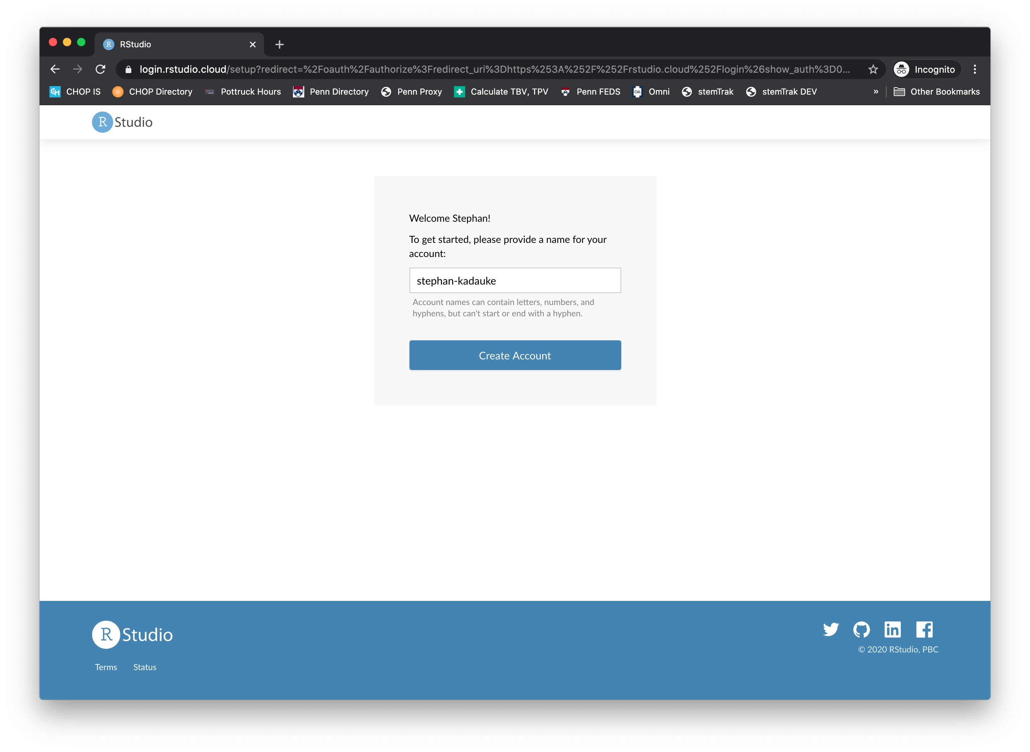
Notes:
At this point, you might have to click on Create Account…

Slide 7
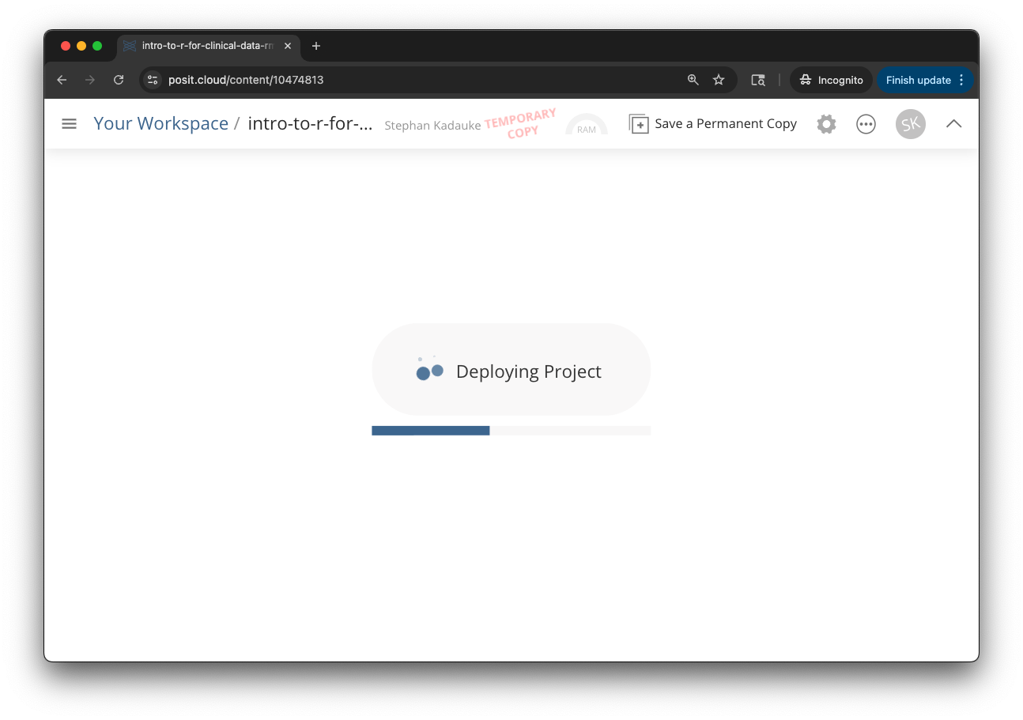
Notes:
But then you should be greeted with the RStudio Workspace which looks like this.
To make sure your work gets saved, click on Save a Permanent Copy.

Slide 8
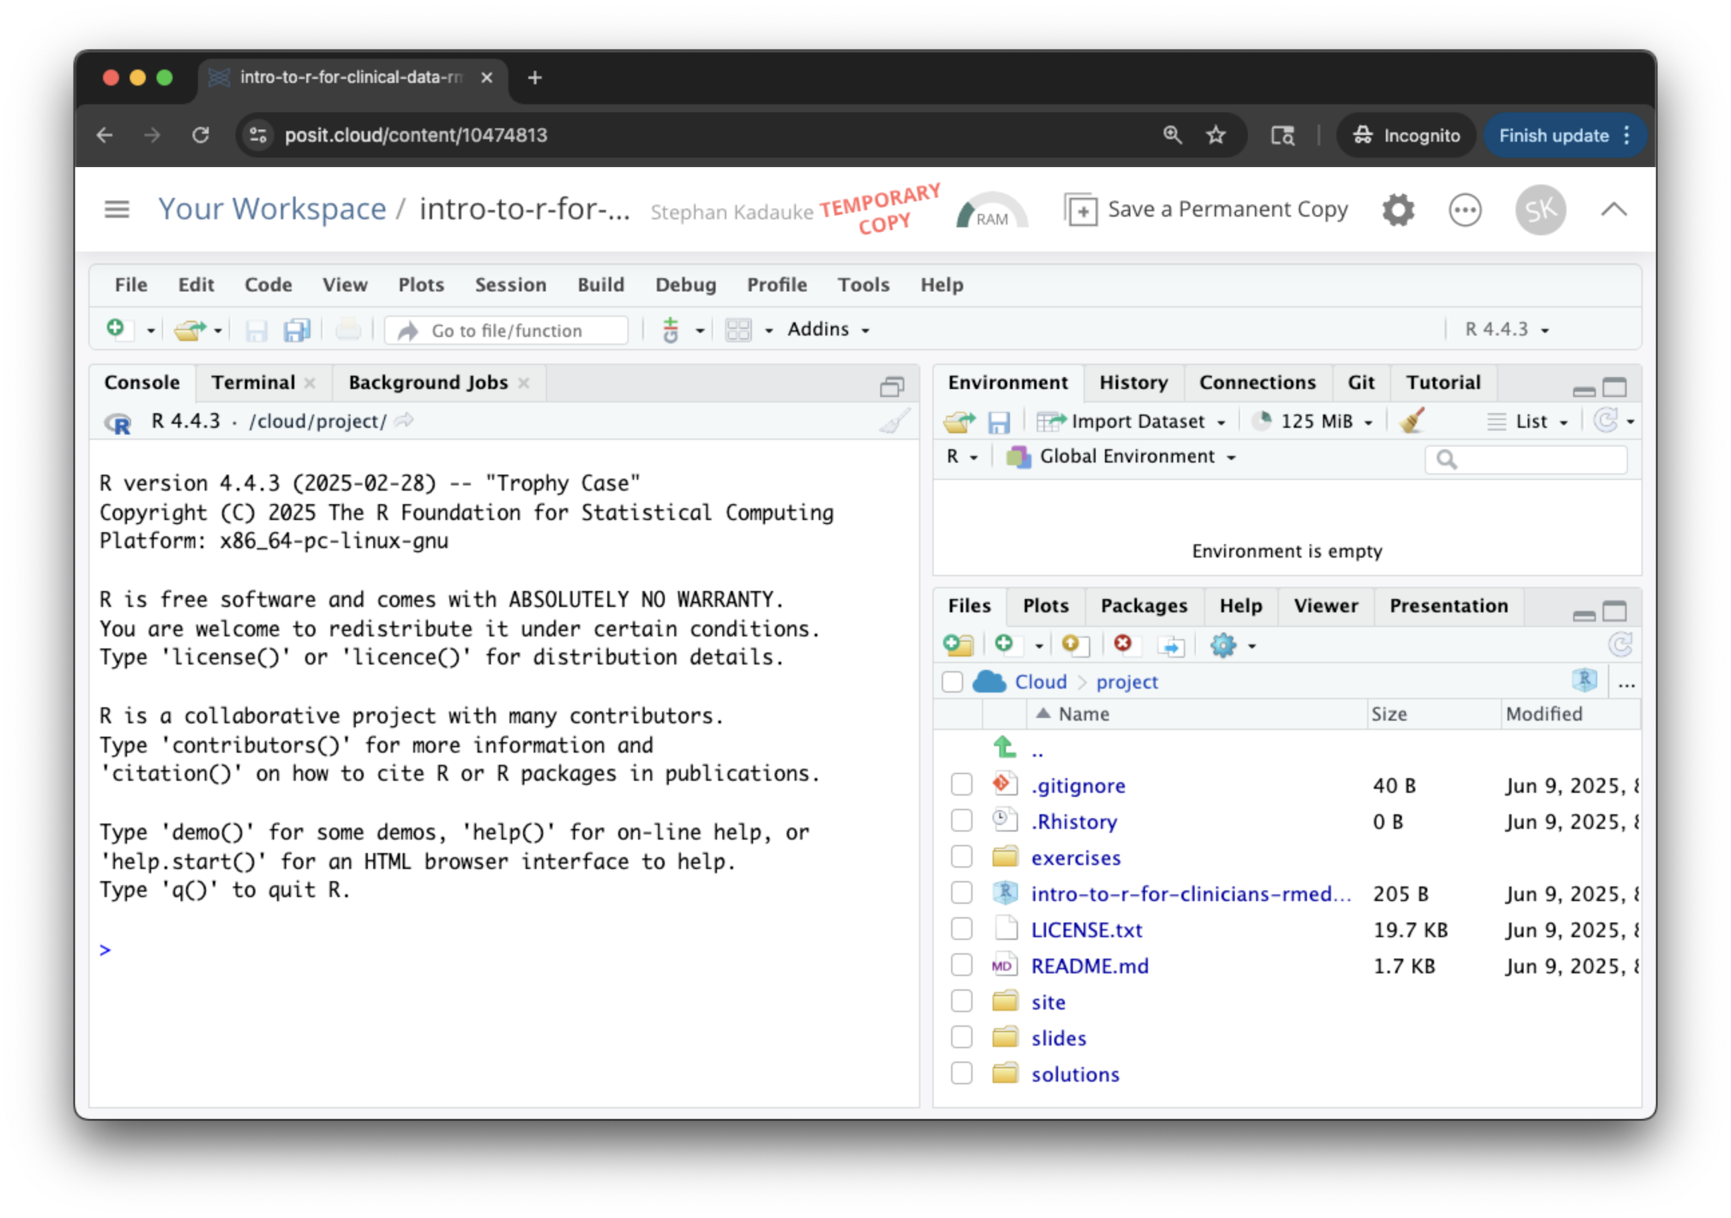
Notes:
But then you should be greeted with the RStudio Workspace which looks like this.
To make sure your work gets saved, click on Save a Permanent Copy.

Slide 9
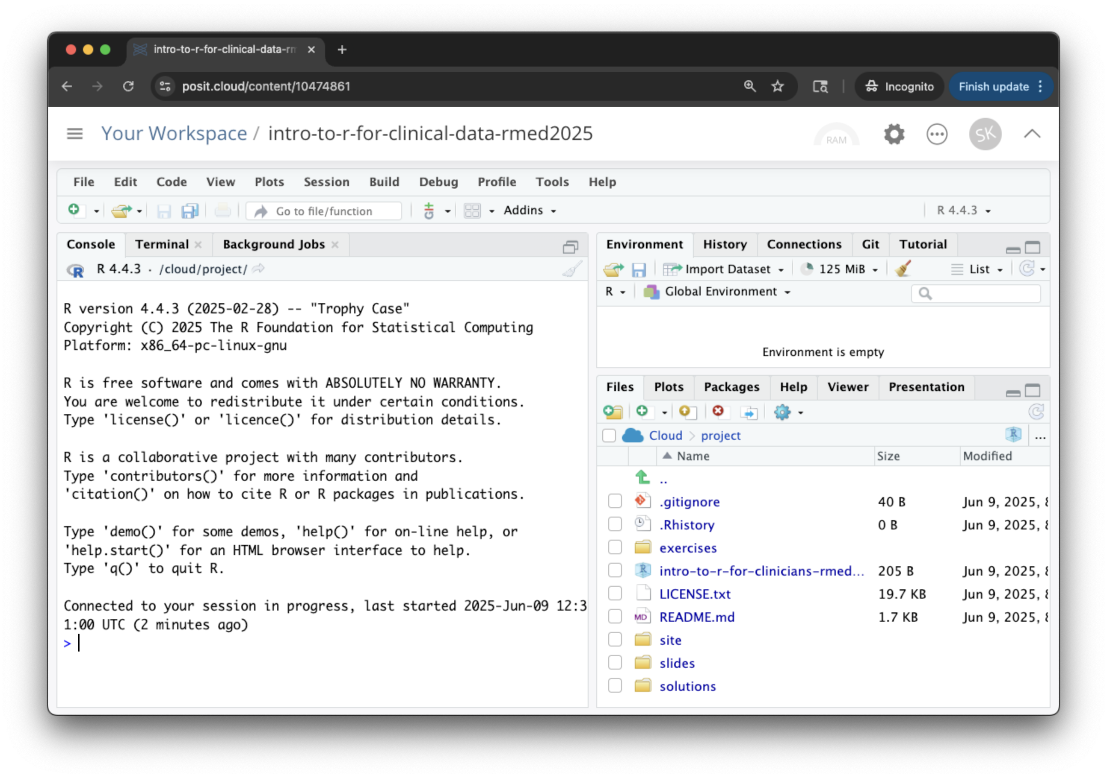

Slide 10
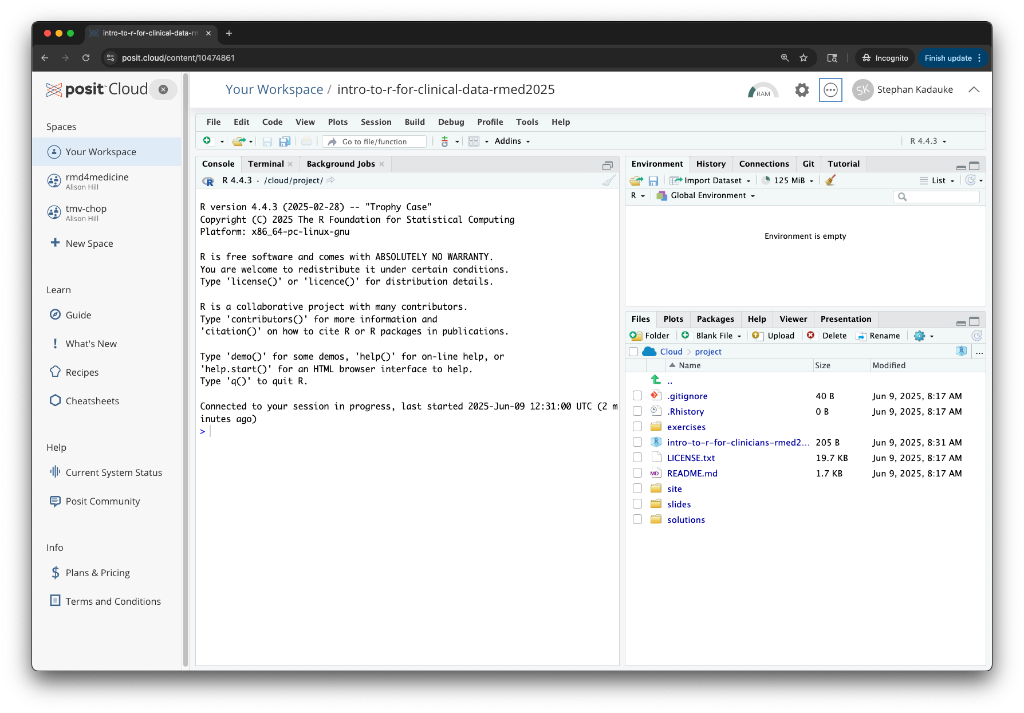
Notes:
If your browser window is large, Posit Cloud will add a top and a side bar. You don’t need these and can close them by clicking on the upwards pointing arrowhead on the top right of the screen, and by X-ing out the left side panel as shown here.

Slide 11
Your Turn #1
Log into the Posit Cloud workspace using the link in the chat.
Click “Save a Permanent Copy”.
X out the left sidebar and close the top bar.
Write “Done!” in the chat when you’re done.
Notes:
Now it’s your turn to get logged into RStudio using the login credentials.
Please click the yes button in zoom to let us know you logged in successfully.
We will do our best to get everyone logged in. If you are struggling to log in, please reach out in the chat and we will try to help you.
In a course this size, we may not be able to get every participant logged in successfully. If you can’t access the cloud, please reach out via the chat so we can connect you with a TA. If we aren’t able to help with your specific issue, don’t worry, follow along via the slides, the course will still be valuable for you.

Slide 12
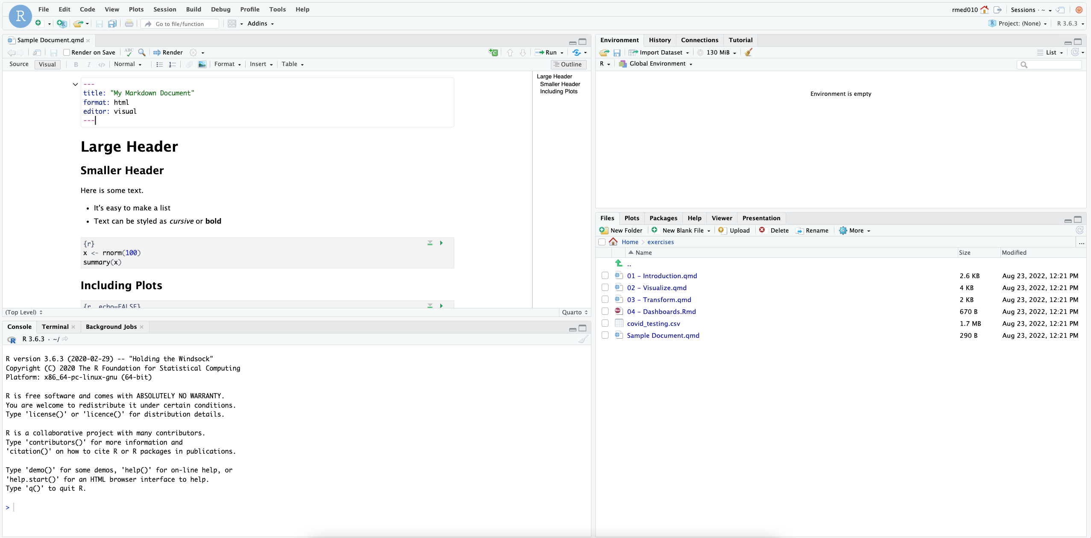
ENVIRONMENT
EDITOR
CONSOLE
MISC
Notes:
Here’s what the RStudio window looks like.
On the top left is the editor. This is where you enter code.
On the top right is the Environment. The environment allows you to look at the data that’s loaded into R. Interacting with data in the environment tab provides some of the functionality you may be familiar with from working in Excel.
The Console is on the bottom left. You can use the console quickly run an individual R command, like install a package. We won’t use the console in this course.
The pane we have labeled “MISC” has a few of tabs. The most important one for today is the “Files” tab which shows the files we’ll be using for the course.

Slide 13
Reproducible Data Analysis and Quarto
Notes:
One of the most powerful aspects of working in the R environment is the ability to conduct reproducible data analyses (those analyses that can be shared, revised, repurposed and reproduced) by others.

Slide 14
18
The Duke Cancer Scandal
Chemo sensitivity from microarrays
Errors first, then cover-up
Clinical trials based on flawed models
Papers retracted, lawsuits settled
Notes:
To highlight the importance of reproducibility, let’s consider the following case.
In the mid-2000s, two researchers at Duke University tried to use microarray gene expression data of tumor cells to predict sensitivity to chemotherapeutic agents. This approach generated a lot of excitement at the time, and the resulting work was published in high-profile journals including Nature Medicine, JAMA, and the New England Journal.
(**) Unfortunately, there were a number of serious errors in the data analysis. The media has focused on the fact that the researchers tried to cover up investigations into these errors and press on towards clinical trials even though there were at the time open questions about the validity of the methods.
(**) Even more unfortunately, patients were enrolled in clinical trials and allocated based on flawed models, and in all likelihood patients were actually allocated to incorrect treatment arms.
(**) In the end, 18 papers were retracted, and Duke settled more than 10 lawsuits for an undisclosed amount of money.

Slide 15
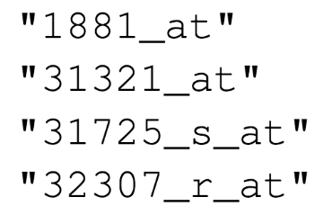
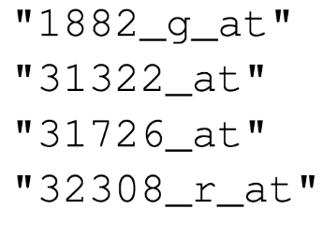

Duke
MD Anderson
Off-by-one indexing error
Notes:
Keith Baggerly and Kevin Coombes, biostatisticians at MD Anderson uncovered the mistakes that led to these retractions, in painstaking work. Let’s look at one of the errors they found.
These are a few of the hundreds of microarray probe sets – each corresponds to a gene – that the Duke investigators reported to predict sensitivity to 5-fluorouracil.
(**) And here are the probe sets that the MD Anderson team got. You can see that those two are different.
(**) If I highlight the last number of each probe, you might notice a pattern: the number of the probe set that Duke reported is exactly one less than the number of the probe that MD Anderson found when they re-did the analysis.
(**) This is what’s called a off-by-one indexing error and is what happens when you use a tool like Excel and accidentally delete one cell. The result is that all the values in the affected column are shifted by one. This is a simple error to make, but as you might imagine, this error invalidates all downstream results.

Slide 16
“Common problems are simple…
Off-by-one indexing error
Sensitive / resistant label reversal
Confounding in experimental design
Inclusion of data from non-reported sources
Wrong figure shown
… and simple problems are common.”
Notes:
The off-by-one indexing error was just one of many simple errors the MD Anderson team discovered.
(**) Another type of error that was pervasive in the study was label reversal so that cell lines were labeled sensitive to a drug when they actually were resistant, and vice versa. That type of error can lead to a scenario where a patient gets the chemotherapy that would be predicted to be least beneficial.
(**) Other problems they identified were confounding, (**) inclusion of data from sources that were not reported in the paper, (**) and wrong figure shown.
These are all simple errors – you don’t have to be incompetent or negligent to make them. (**) Because these errors are so easy to make and because without good documentation or a reproducible workflow it’s hard to catch them, they are also very common.

Slide 17
Point-and-click is not reproducible
Computer code can precisely document each step of the analysis
Notes:
A key issue in this case study is that the investigators used “point and click” tools like Excel.
This prevented peers and independent investigators from catching errors in the analysis, until it was too late.
And the Duke case study is only one example where the critical barrier to reproducibility was the tendency of investigators to use graphical user interface “point-and-click” type tools. These interactive tools usually don’t record user actions and because of this, they are fundamentally not reproducible.

Slide 18
Why YOU should analyze your data reproducibly
“Can we redo the analysis with this month’s data?”
“Why do the data in Table 1 not seem to agree with Figure 2?”
“Why did I decide to omit these six samples from my analysis?”
Your closest collaborator is You from 6 months ago
Notes:
But reproducibility doesn’t only help others. Consider the following 3 statements and ask yourself if they sound familiar.
-Can we redo the analysis with this month’s data?
-Why do the data in Table 1 not seem to agree with Figure 2?
-Why did I decide to omit these six samples from my analysis?
**Your closest collaborator is you from 6 months ago. You can do yourself a huge favor by using tools that promote reproducibility.
And if you are analyzing clinical data and might affect patient management or public health based on your findings, that makes it so much more important that you take steps to assure your analysis is documented, free of errors, and reproducible by others.

Slide 19
Notes:
Quarto provides us with features and tools to tackle the reproducibility problem.
In Quarto, we can craft computer code mixed in with narrative annotation that documents the purpose of the code and details about the decisions we made in our analysis.
Quarto provides a lab notebook interface for analysis, visualization, and annotation of our work.
Like R Markdown before it, Quarto is quickly becoming the gold standard for reproducible data analysis. In the course we will teach you to use Quarto and we encourage you to continue using it consistently in your future work. In fact, it is the strongest recommendation we will make to you today.

Slide 20
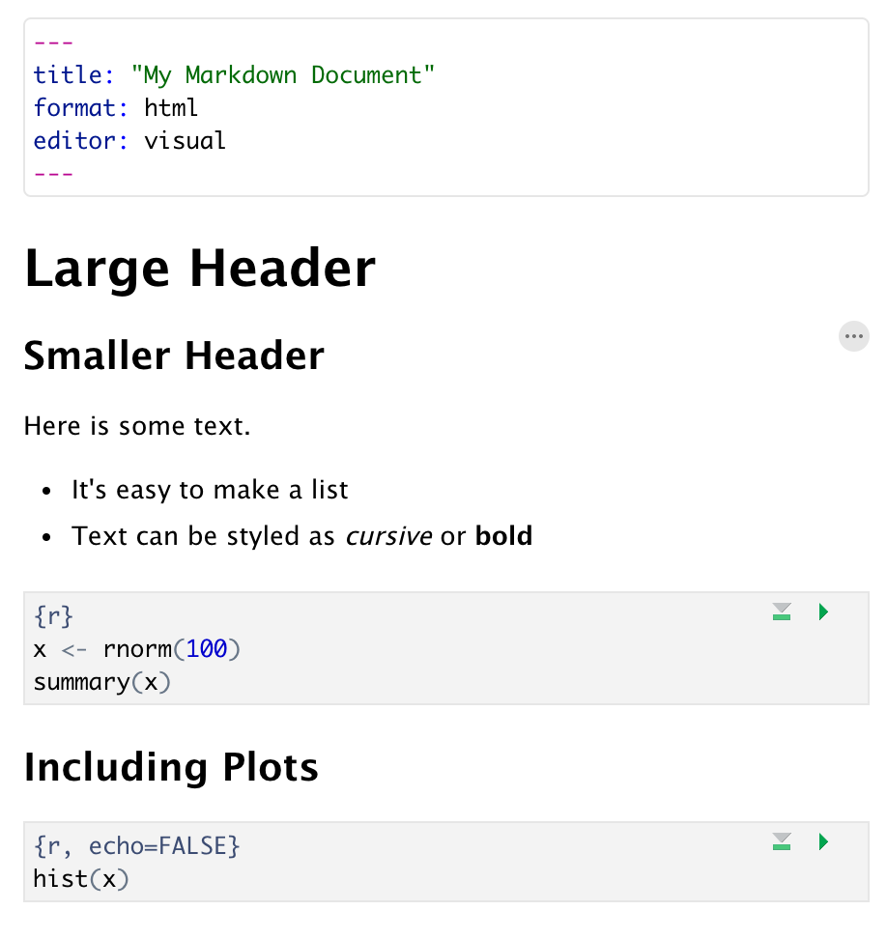
Anatomy of a Quarto Document
Header
Header
Text (w/ formatting)
Code chunk
Notes:
Quarto documents are composed of 3 types basic building blocks.
**The first is the Header which is always on the top and is required. This often includes the title of the document, the desired output format, and which editor we’re using – visual is the default and it makes editing a little easier because the user interface is more like MS Word and less like a traditional code editor.
**The second type of block is the text. You can have as many text blocks as you want. Quarto allows some basic formatting like having different sized headers and bullet point lists but it’s not as extensive as MS Word.
**The final type of block is called “code chunk”. Code chunks include include R code that can be executed to output results. Code chunks have a gray background and a different font to be visually distinct from text blocks.

Slide 21
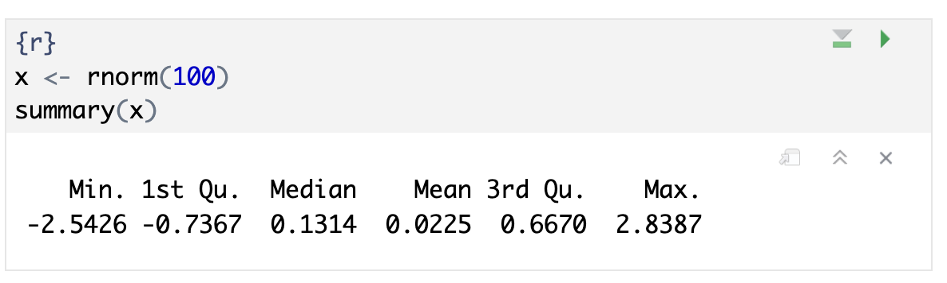
Notes:
Let’s zoom in on the code chunk. This is super important and may not be familiar to you even if you’ve done some programming in other languages such as Python before.
Here we have a code chunk that’s written in R. We know this because the top of it says R in curly braces.
Then there are two lines of code. Don’t worry about understanding the code for now. But basically what happens here is that we use the rnorm function to generate 100 random values from the standard normal distribution and we’re assigning them to a variable x. x will hold those 100 values in what’s called a vector, which is sort of a list of numbers.
Then we call the summary function on x. The summary function is designed to take a vector of numbers and output some statistical summaries, like minimum, maximum, etc. The details aren’t important here.
Look what happens when we click the green triangle on the top right. *** This runs the code chunk in the editor and shows the result right below the chunk.
One more detail to note here. The green triangle runs the current chunk only. The symbol on its left runs all code chunks above this one but not the current one. This can be extremely useful if you have code above that sets up some data.
When you write a document in Quarto you will use those two buttons ALL THE TIME. So I want to stop here for a minute and make sure everyone understands this or if there are any questions in the chat at this time.

Slide 22
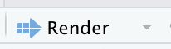
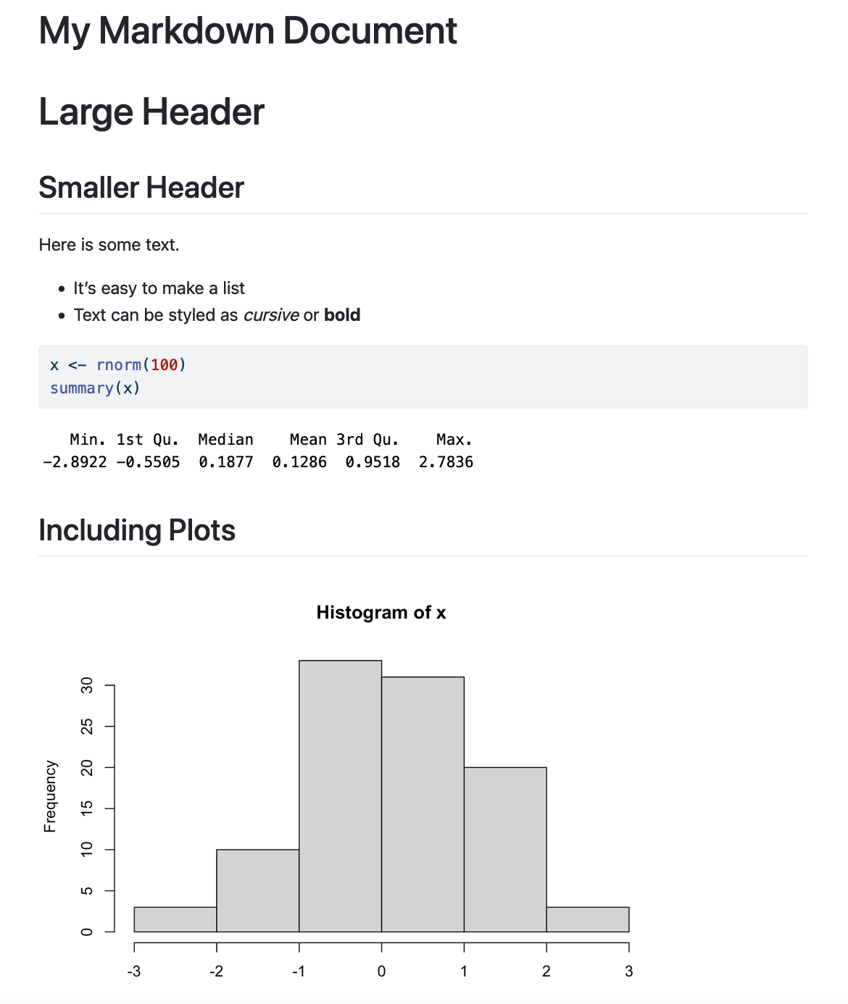
Notes:
At some point you might want to create a human readable shareable version of your document. This is called rendering. *** You can render the document by clicking the Render button.
*** You can see that the output is a neatly rendered document with the code and results shown.

Slide 23
Notes:
Let’s zoom out a little now and look at this Quarto document in greater detail
The first block is header section, showing the title, saying that we’ll render into HTML, and that we want to use the Visual editor.
** The second block is a TEXT block.
** Then we have a CODE CHUNK. This code chunk sets up the x vector and outputs a text summary.
** Then we actually have another TEXT chunk which just says “Including Plots”
** Then we have another code chunk, and this one invokes the hist function to create a histogram. One super important thing to note here: I can use the x variable I defined above in the first code chunk in that second code chunk! This is because when I’m working in the editor on a Quarto document, R is running in the background and keeps track of all variables.

Slide 24
Your Turn #2
Open a sample Quarto document (File → New File → Quarto Document).
- Enter ”R/Medicine 2025” for the Title and click Create.
- Install R Markdown by clicking on the Install link that shows up.
- Review the format of the document: header, text blocks, code chunks
- Execute each individual code chunk in order by clicking the green triangle.
- Render the document to HTML. You will be prompted to save your Quarto Document first. Write “test” and click save.
- Click “Try Again” if you get a prompt about opening an external browser.
- Review the rendered document. Did the first code chunk show up? How about the second one?
Notes:
Ok, it’s time to practice!
Follow the instructions in Your Turn #2 to
-open a Quarto document
-review the format
-execute individual code chunks
-render the document
We will meet back in 3 minutes to review this exercise together.

Slide 25
Importing Data
Notes:
Now that we looked at how to create Quarto documents we can begin the process of performing data analysis in R in earnest by importing a clinical data set.

Slide 26
The Data Analysis Pipeline
Notes:
This diagram may look familiar, you saw it in the Welcome presentation.
The first step in the data analysis pipeline is to load (**) the data into the environment so we can begin to tidy and transform that data.
In today’s course we will be using a de-identified data set consisting of COVID-19 laboratory test results from a microbiology lab. This data is stored as a CSV file.

Slide 27

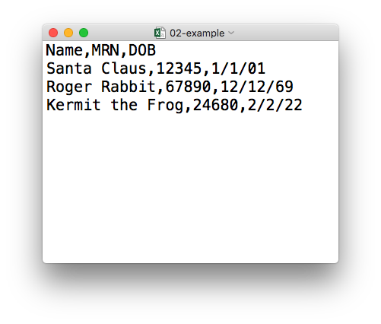
plain text (“flat”) file
csv
rectangular structure
header row
Notes:
So what’s a CSV file? CSV stands for comma-separated values.
** A CSV file is a plain text file, which means you can open it in a text editor and look at it.
Here we have a CSV file with the names, medical record numbers, and dates of birth for three fictional “patients”
** This data structure is called rectangular because it falls into rows and columns, where each row has the same # of columns, and each columns has the same # of rows.
** Also note that this particular CSV file has a header row that instead of data, has a descriptor of what kinds of data are found in each column. CSV files often but not always have such a header row.

Slide 28
Tidyverse: R Packages for Data Science
A consistent way to organize data
Human readable, concise, consistent code
Build pipelines from atomic data analysis steps
Notes:
To import our CSV data, we need some additional data analysis tools. In this course, we will be leveraging the Tidyverse.
The Tidyverse is a modern set of tools for data analysis in R. It’s quickly becoming the de facto standard for doing data science with R.
The basic tenets of “tidy” data analysis include:
Data should be organized in a consistent, standardized way. Each row is an observation, and each column is a variable. This is a very common way to organize data in a spreadsheet and might sound familiar from how you may already organize data in tools like Excel.
Programming code that acts on the data should be consistent, concise, and mimic the narrative language as much as possible.
Each data analysis can be broken down into a series of atomic steps, such as “select this column” or ”arrange the data by the values in that column”. Accordingly, an arbitrarily complex data analysis can be broken down as a pipeline of atomic steps.

Slide 29
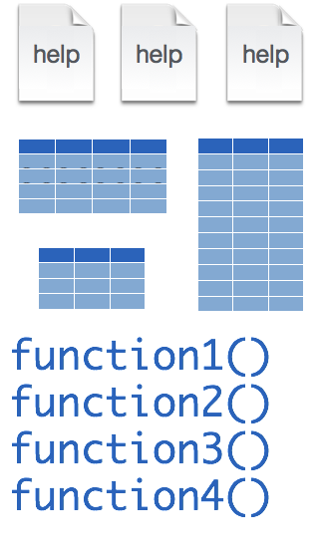
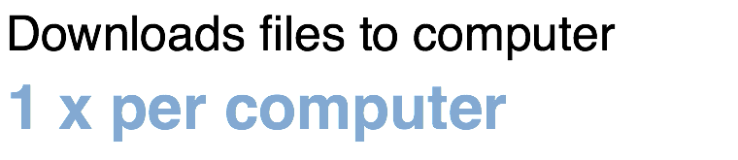
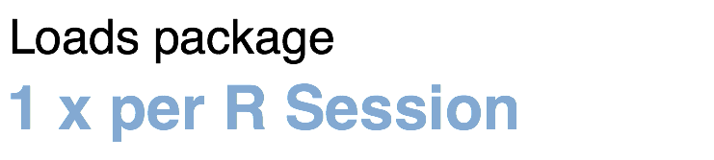
Installing and loading R packages
tidyverse
install.packages("tidyverse")
library("tidyverse")
Notes:
The Tidyverse is package (a collection of functions, data, and help documentation) that we can use to extend the functionality of R.
Packages need to be installed explicitly – with the command install.packages. So let’s say you want to install a package named “tidyverse”. You go to the R Console and type install.packages(“tidyverse”).
Each package you want to use needs to be installed only once on each computer. However, in order to use the functions or data in the package, you also need to load the package. This is done with the command “library”. So to enable all the functions in the “tidyverse” package, you type library(“tidyverse”). Packages remain loaded until you quit R. So every time you start a new R session you have to load each package that you want to use again.
*** On Posit Cloud today, you might be prompted to install missing packages with a warning that looks like this. Click on the Install link when this appears.
So these are the first two R commands we’ve covered - install.packages and library.

Slide 30
Your Turn #3
In the Console, type:
The installation might take about 5-7 minutes.
Type “Done!” in the chat once the installation has started.
install.packages("tidyverse")
Notes:
Let’s actually go ahead and install the tidyverse. This will save us some time later on when we’re doing exercises that use the tidyverse packge.
…

Slide 31

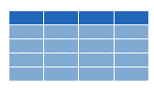

read_csv()
data_frame <- read_csv(file_name)
csv
Notes:
Once, the Tidyverse package has been loaded via library, we can import CSV files using the read_csv() function.
Here is a template for how to use the read_csv function to create a data frame object from a CSV file.
You start with the name of a data frame object then you have this left-ward arrow then read_csv and then the file name in parentheses.

Slide 32
function
(does stuff)
data_frame <- read_csv(file_name)
Notes:
This code construct is exceedingly common in R, so I want to spend a few minutes exploring it together
read_csv() is a function. Remember that functions are defined in packages. We loaded the Tidyverse package to be able to use the read_csv function.
You may be familiar with functions from math class. A function takes an input, say an ‘x’ value and returns an output, say a ’y’ value. Functions in computer programming also take inputs and return outputs. But the inputs and outputs here are the arguments and objects that exist within the context of a programming language.
For read_csv, the input is the file name of a CSV file; and the output is a data frame with the contents of the file.

Slide 33
function
(does stuff)
argument
(input)
data_frame <- read_csv(file_name)
Notes:
The input that goes into a function is called an argument. The argument to a function gets put in parentheses.
A function can have zero, one, or many arguments. If there is more than one argument, we use commas to separate them. We’ll see examples of that later.

Slide 34
object
(stores output)
function
(does stuff)
argument
(input)
data_frame <- read_csv(file_name)
Notes:
- The read_csv function outputs a data frame (think table), but if we want to *capture* that data frame inside of a named object, we need to specify that explicitly. It is a great idea to capture the output of a function in an object so it can be used as the input for other functions, for example to summarize or visualize the data in the named object.

Slide 35
object
(stores output)
function
(does stuff)
argument
(input)
data_frame <- read_csv(file_name)
assignment operator
(“gets”)
Notes:
To put the output of the read_csv function into a named object, we use the assignment operator.
The assignment operator is a smaller-than followed by a dash or minus and looks kind of like an arrow pointing left. It’s usually read as “gets.”

Slide 36
read_csv()
data frame to read data into
name of
CSV file
covid_testing <- read_csv("covid_testing.csv")
covid_testing
covid_testing.csv
csv
Notes:
Let’s put these pieces together to load our covid data set.
This line of code reads the “covid_testing object gets the output of the read_csv function on the covid_testing CSV file”.
You might notice that one of the objects is put in quotes and the other one isn't.
To be honest, quotes can be confusing. Names of objects such as data frames don't get quotes. In contrast, literal file names are always put in quotes. This is part of the grammar of coding (the syntax) in R that will become more familiar to you as you develop proficiency and comfort with the language.

Slide 37
Your Turn #4
In the MISC pane, select the folder:
“exercises”
Select the Quarto document file:
“01 – Introduction.qmd”
In the Editor pane, follow the instructions to complete the exercise.
Notes:
One final your turn in this session.
In this exercise, we will ask you to open a Quarto document and follow the instructions contained in that document to load and explore our data set.
We will meet back in 5 minutes to go over this exercise together.

Slide 38
Recap
Programming Language
Document Format
IDE
Packages extend the functionality of R. They need to be installed once per computer and loaded each session.
Functions do stuff. They accept Arguments to define parameters. We can store the output of functions in Objects using the assignment operator ( <- ).
Importing Data is the first step data analysis pipeline. read_csv() is a function from the tidyverse that we can use for importing data.
Notes:
To recap what we have covered in this introductory lesson.
We started by defining and differentiating R (the programming language) from Rstudio (the development environment) from Quarto (the document format we use for reproducible data analysis).
In addition to learning to create and edit Quarto documents we discussed some basic coding vocabulary including:
-Packages (such as the Tidyverse) which extend the functionality of R. We use the install.packages() function to install packages, and the library() function to load them into the environment.
-Functions do stuff on our behalf, they accept arguments, and we can store their output in named objects using the assignment operator.
-Finally we discussed and practiced importing data using the read_csv() function from the tidyverse, and explored this data visually.

Slide 39
What else?
Notes:
At the end of each lesson we have included a what else section to introduce you to ”what else” you may want to explore and learn about after completing this course.
This includes helpful hints, other functions in the Tidyverse, and exciting packages you may want to check out.

Slide 40
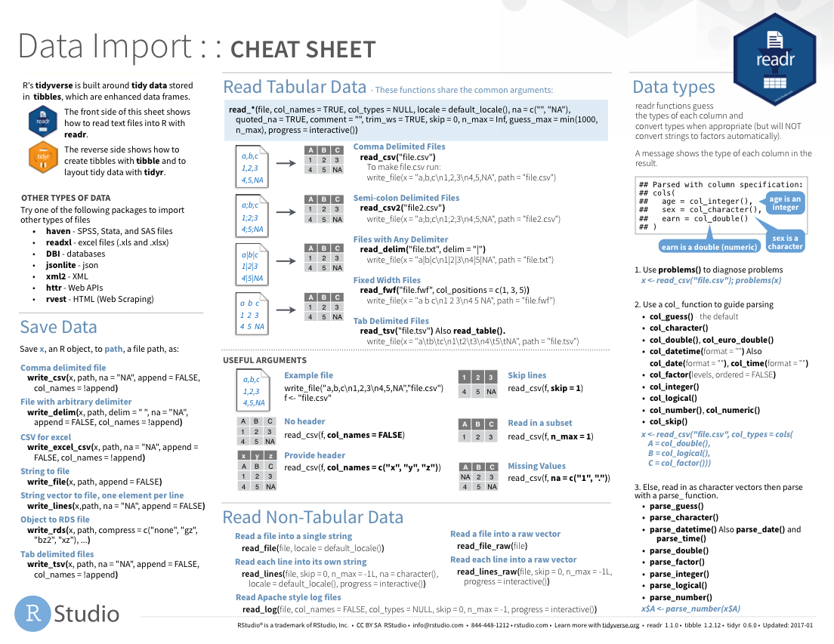
Notes:
The Data Import cheat sheet helps with the grammar of importing data including other file types and those with other separators (like pipes “|” instead of commas).
The Data Import cheat sheet is available on the Posit website.

Slide 41

Notes:
There are a variety of other packages out there designed to deal with different file formats:
Readxl: Excel
Googlesheets4
Jsonlite: JSON data and APIs on the web
Haven: SPSS, Stat, SAS files
REDCapTidieR: REDCap data

Slide 42
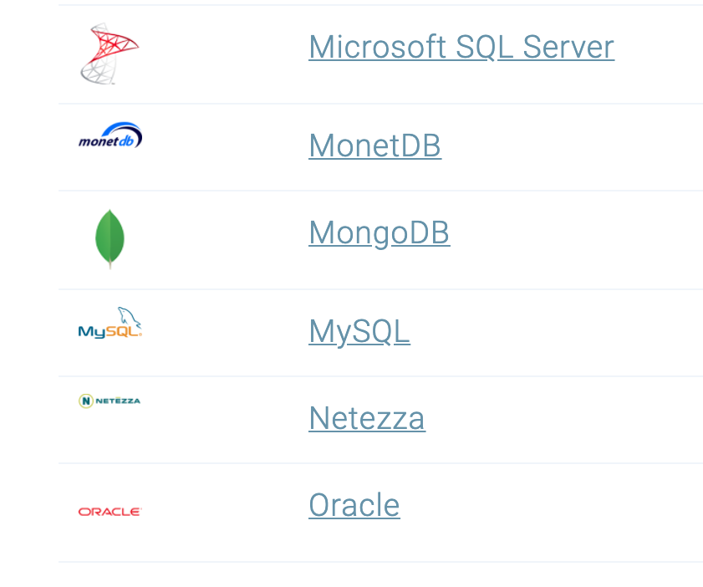
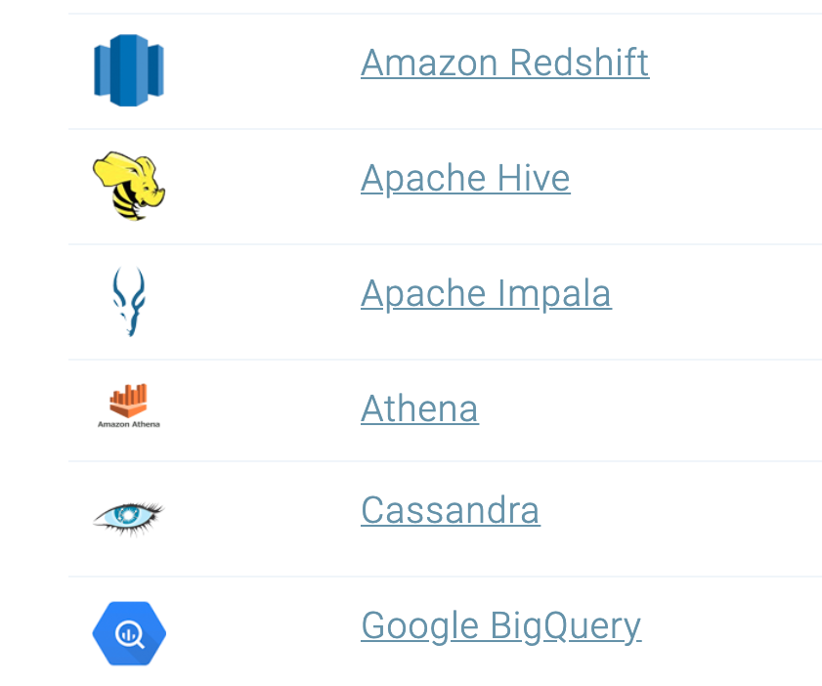
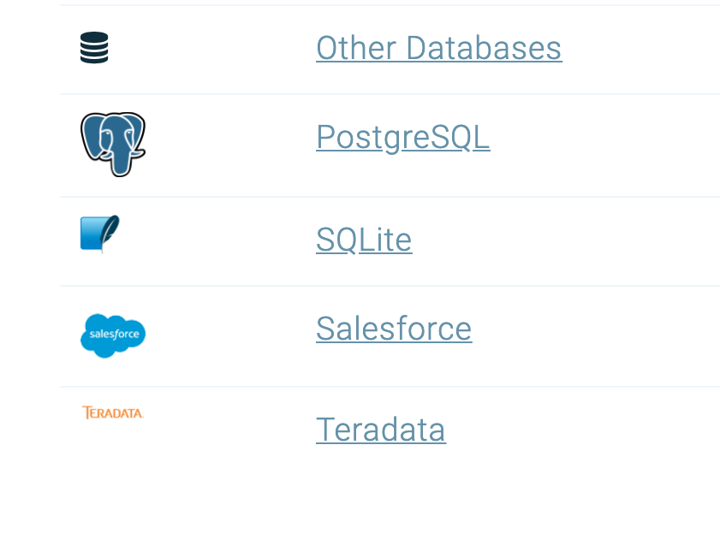
Databases
https://db.rstudio.com/databases/
Notes:
You can also connect to a variety of different databases directly in R to source your data.
If you use any of these, you may want to check out the tools to make database connections in R.

Slide 43





Notes:
In this lesson we practiced “rendering” our analysis to an HTML file.
In addition to HTML files, Quarto documents can be “rendered” into a number of additional formats including PDF, Microsoft Word, PowerPoint, and support for interactive dashboards is even on the horizon. We will look at dashboards in greater detail later in the course.

Slide 44
R Interface to Python
```{python}
import pandas
covid_testing.info()
```
Notes:
The reticulate package provides an interface between R and python.
This means, you can mix code chunks written in R with code chunks written in Python.
R does many things really well, but no programming language is perfect for all tasks. It is great that R gives us tools to mix and match languages in different code chunks in situ.
For those of you new to coding, we recommend focusing on a single language to develop proficiency before moving on to another language. This will shorten the learning curve for your first and future languages.

